Slide 1

Track Self
Modern Application development- 1

Slide 2
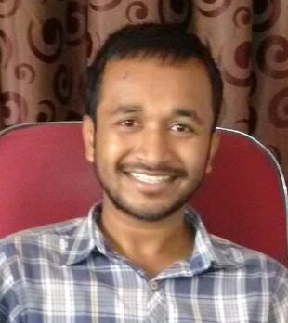
About me
Sandeep, Nalla
Software Engineer
FTD India Private Limited
Hyderabad

Slide 3
Approach
Basic UI & API functionality
Tracking Dashboard
Aesthetics
Optimization

Slide 4
Key functionalities
CRUD operations on Trackers
CRUD operations on Log
Tracking Dashboard – Plotly JS library
Login feature

Slide 5
Additional Features
Admin Dashboard
Register feature

